Slide 1

Movies Data Set Analysis
Exploring the movies in terms of ratings and revenue
Milan Karahiaur
28/07/2023

Slide 2
Agenda
1. What’s the most popular genres?
2. Does the run time affect the rating?
3. Exploring MPAA Ratings of movies.
4. Which movies are the most profitable?

Slide 3
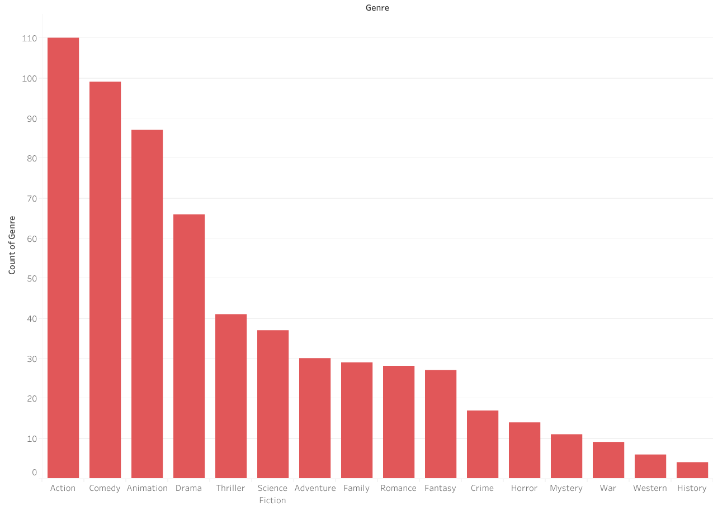
Movie Count for each Genre

Slide 4
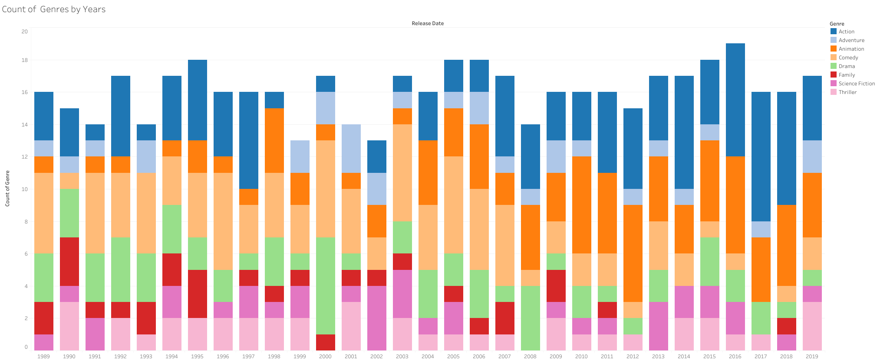
Movie Count by Years

Slide 5
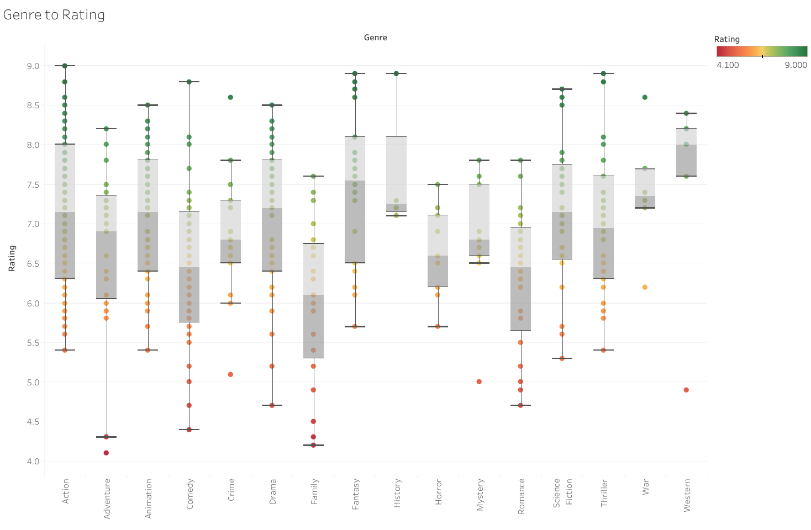
Genre to Rating

Slide 6
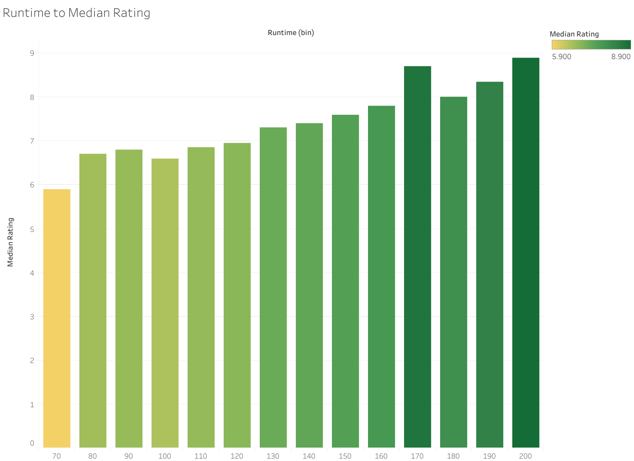
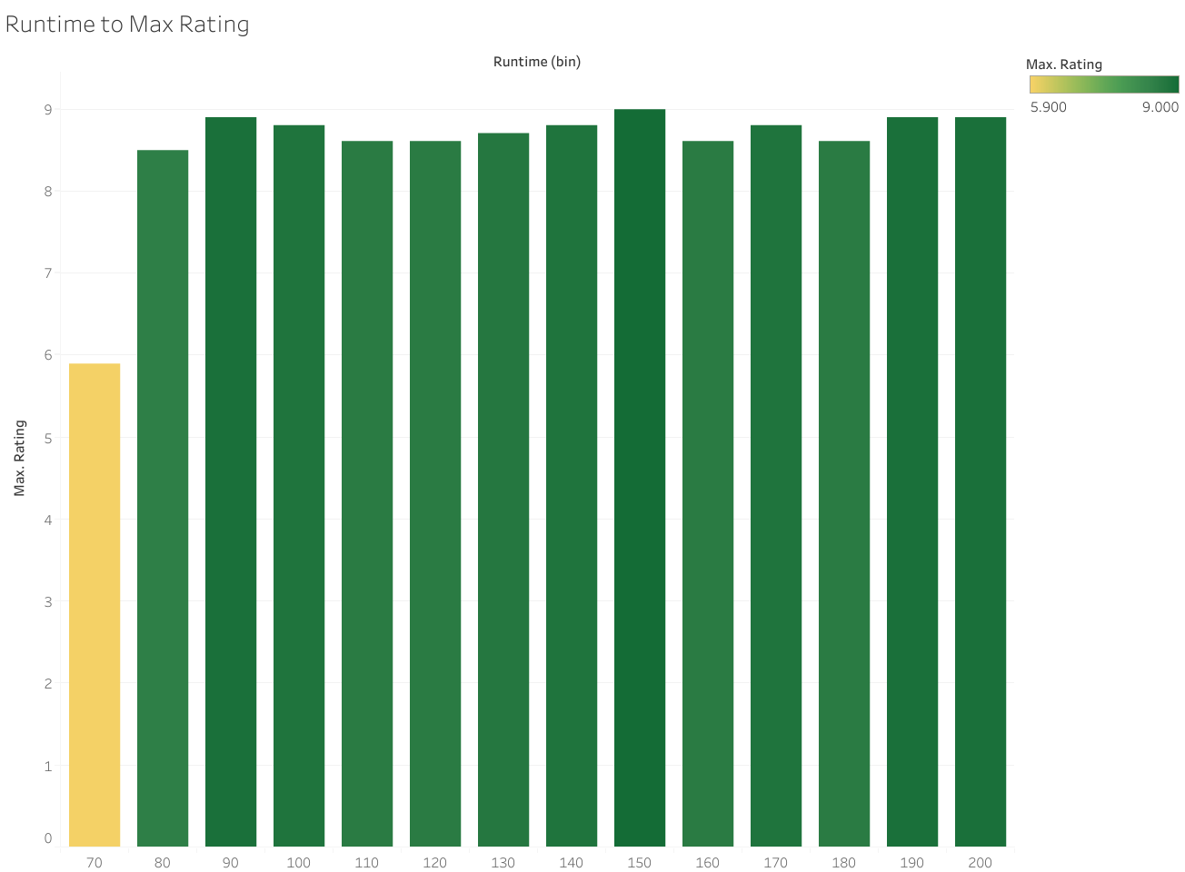
Runtime to Rating

Slide 7

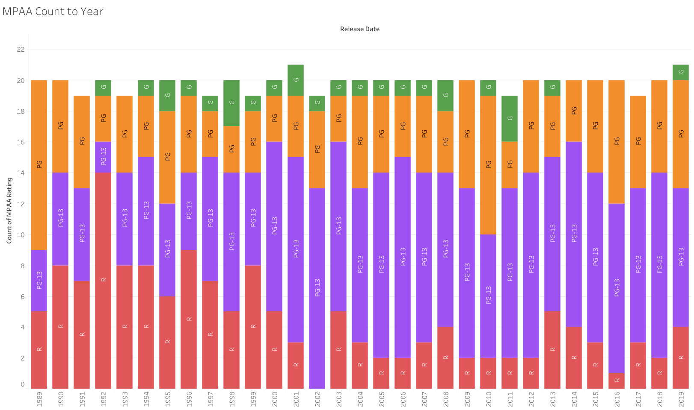
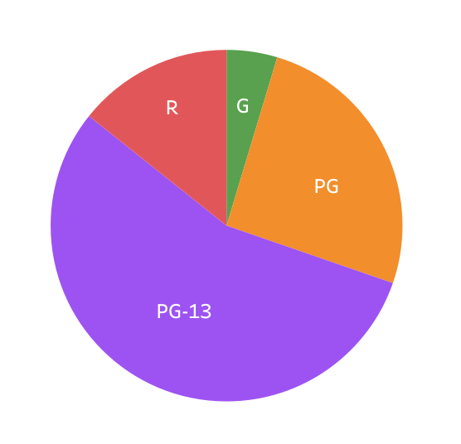

MPAA Rating
MPAA Rating to Gross

Slide 8
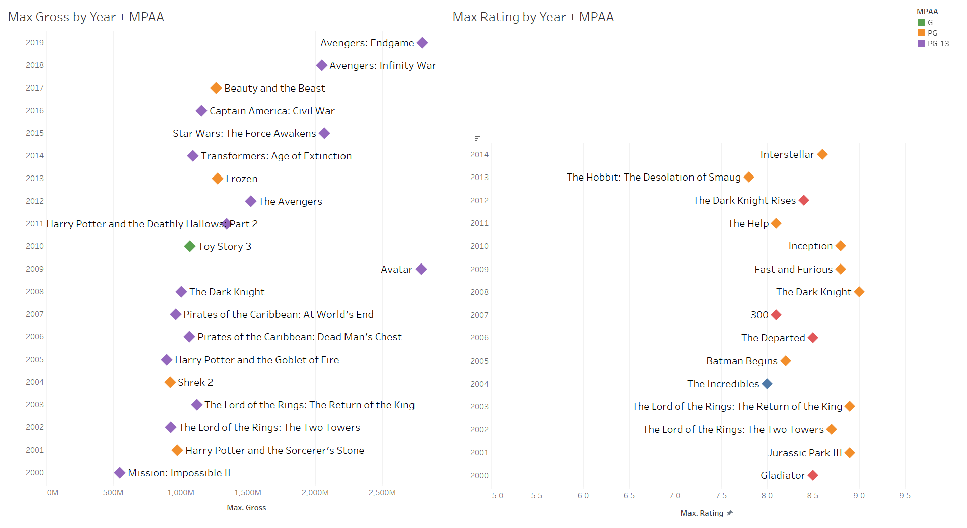
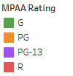
Max Gross to Max Rating
Comparing movies with the most gross to movies with the highest rating by years

Slide 9
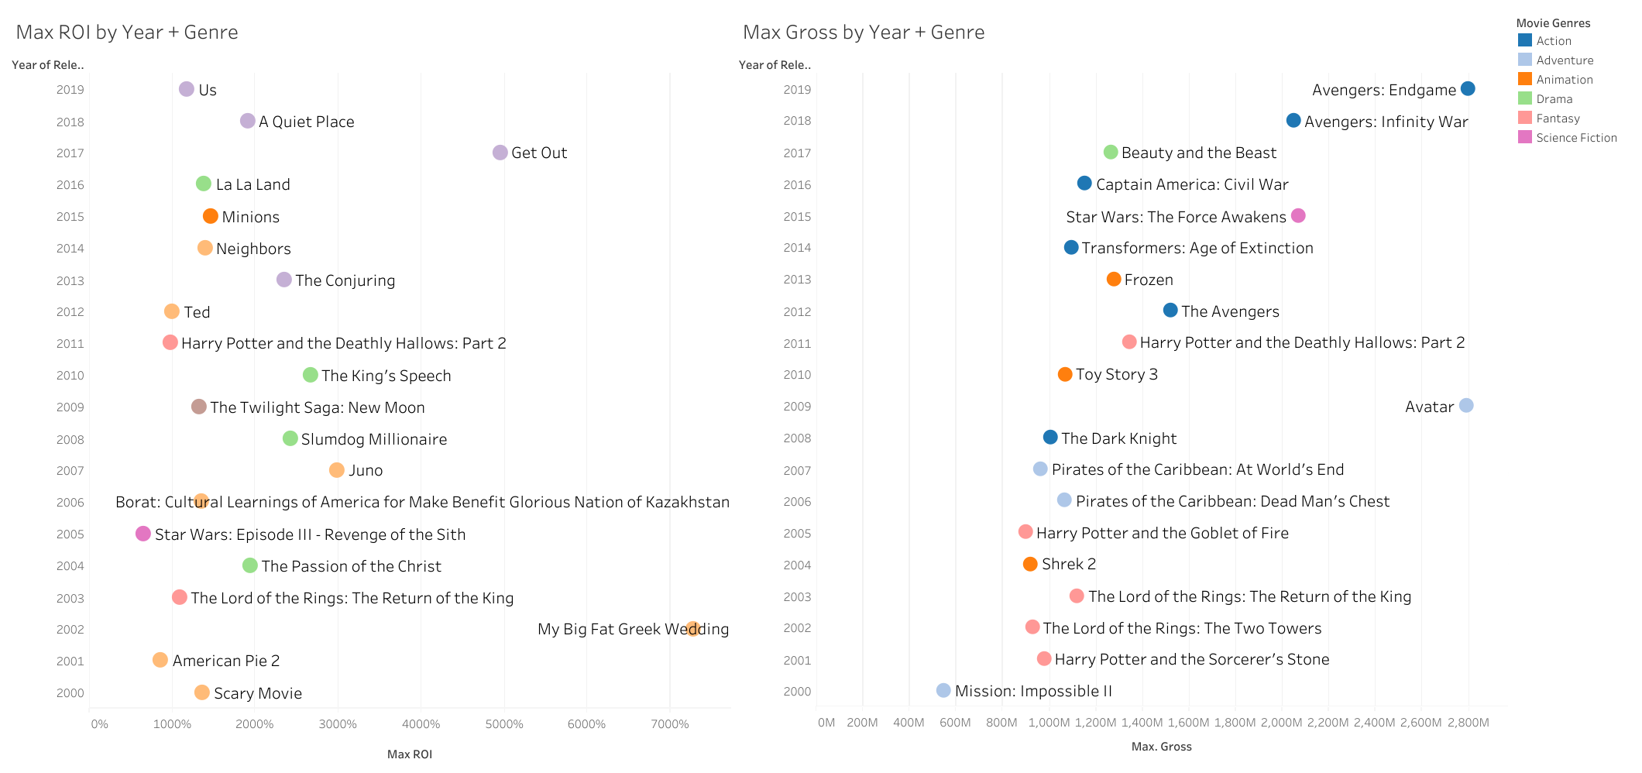
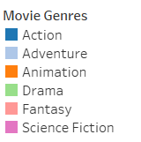
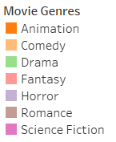
Max Gross to Max ROI of Genres
Comparing movies with the most gross to movies with the highest Return of Investment by years

Slide 10
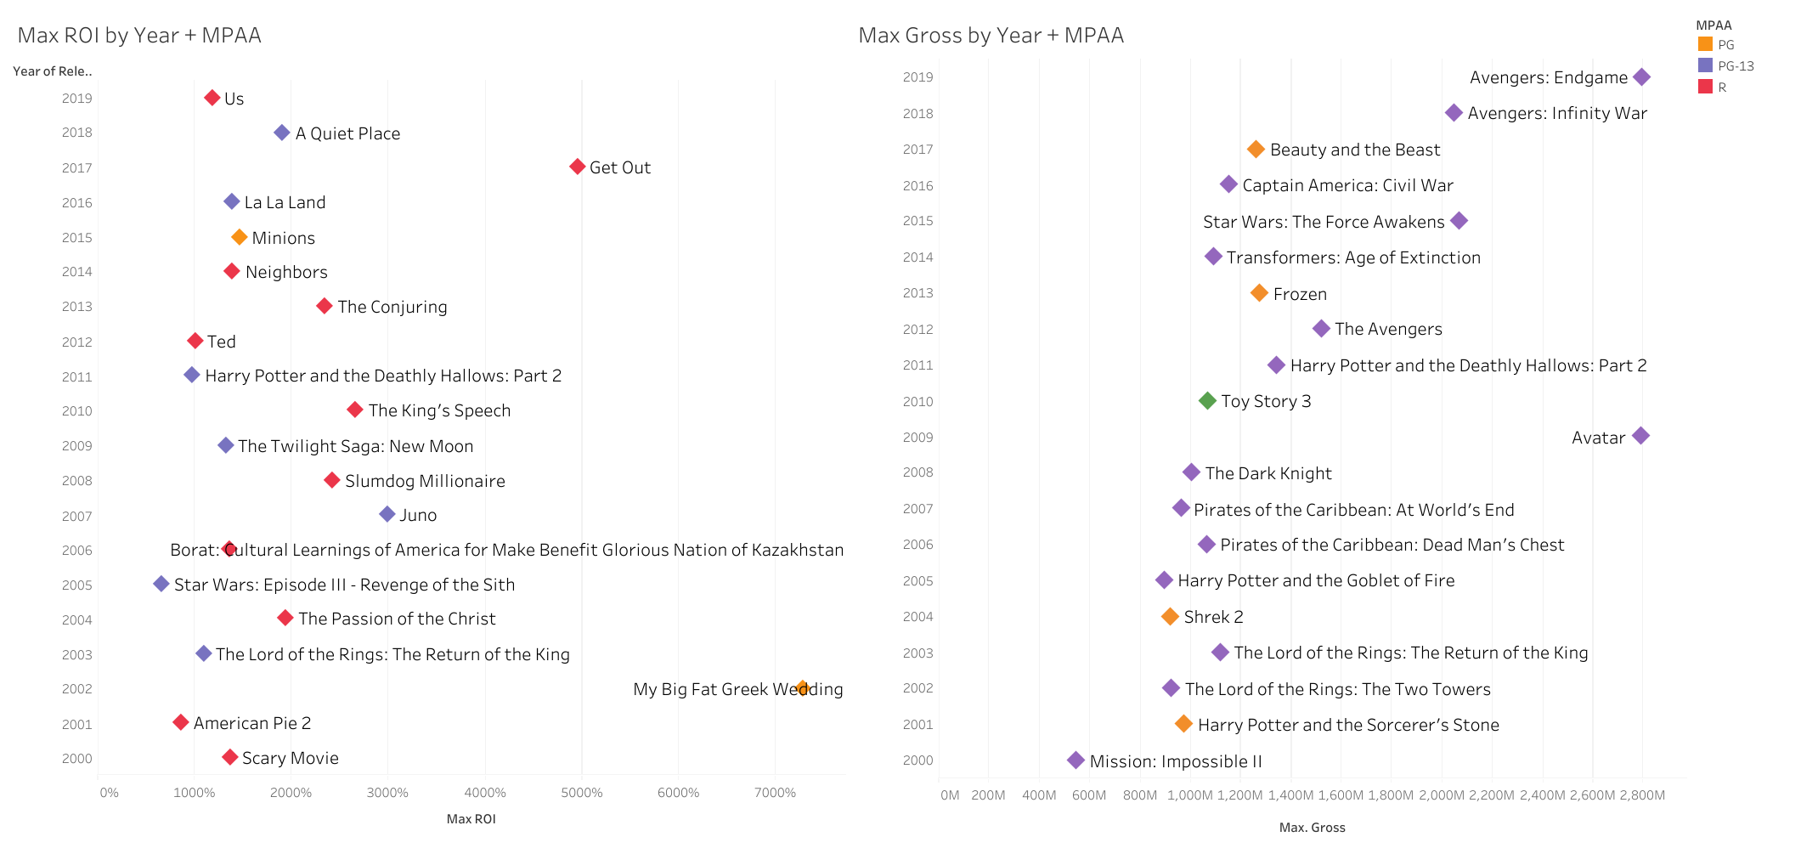
Max Gross to Max ROI with MPAA Ratings
Comparing movies with the most gross to movies with the highest Return of Investment by years

Slide 11
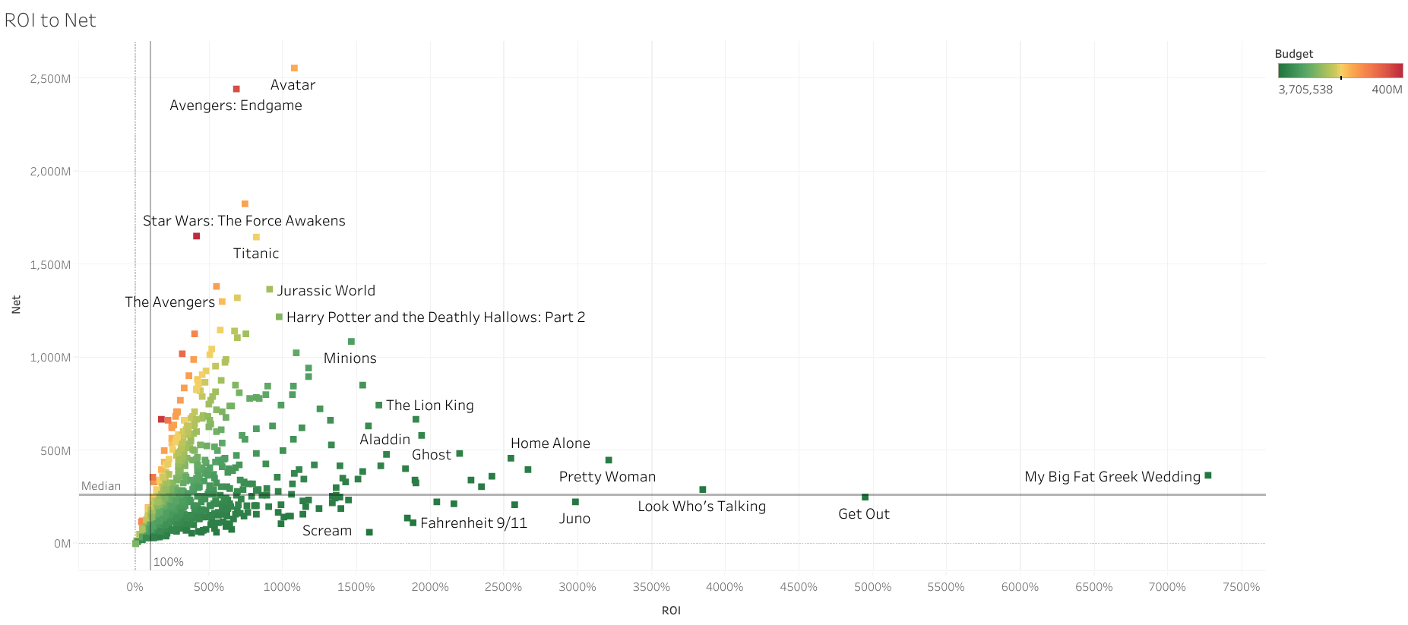
Net to ROI
Comparing Return of Investment to Net

Slide 12
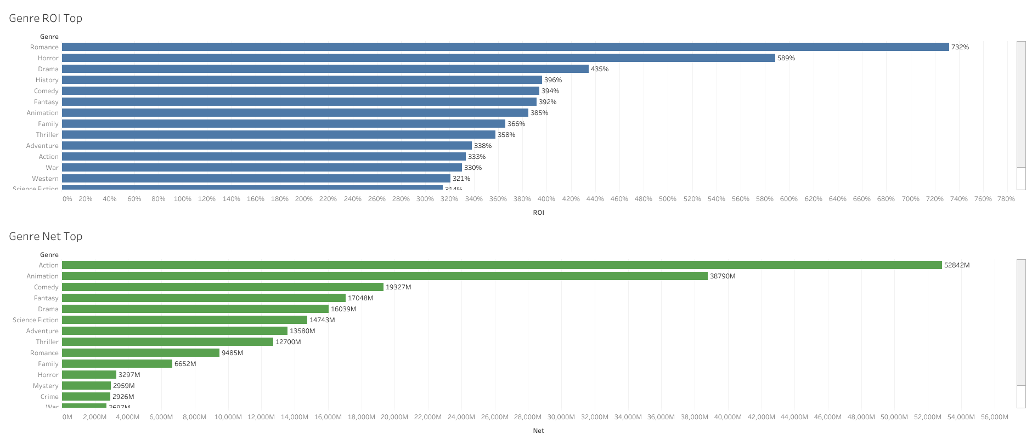
Net vs ROI
Comparing Return of Investment to Net by Genres

Slide 13
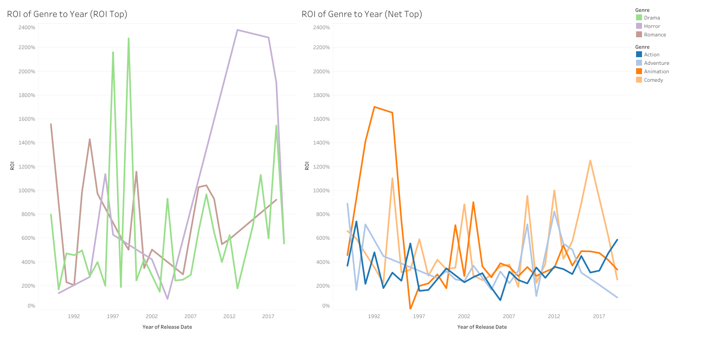
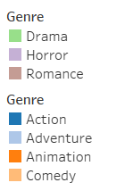

ROI of Top Genres
Comparing Return of Revenue of Top Genres by ROI and Top Genres by Net Profit

Slide 14
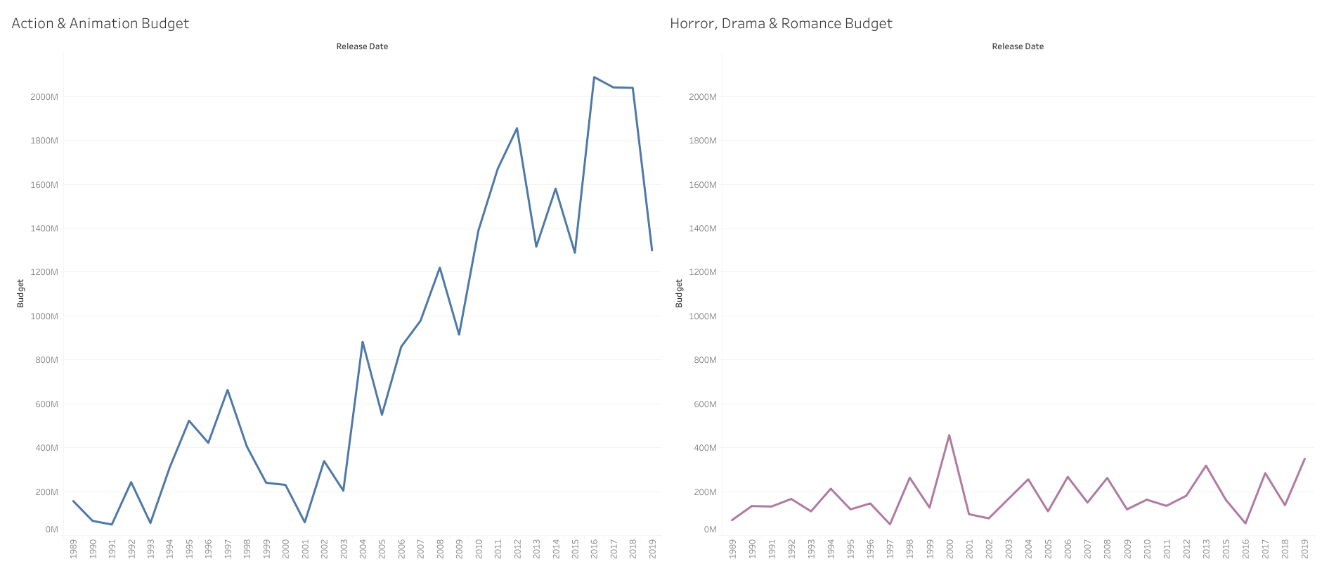
Comparing Budgets
Comparing budgets of Action & Animation movies to budgets of Horror & Romance movies

Slide 15
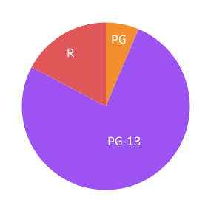
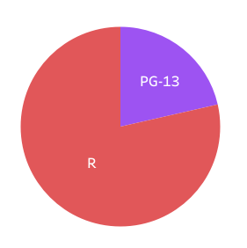
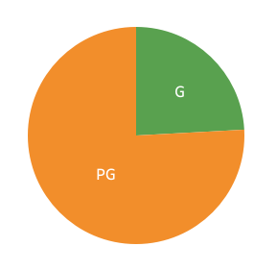
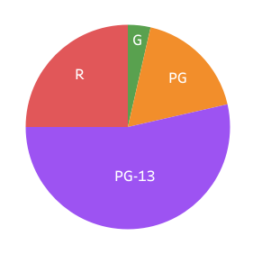
MPAA Ratings
1. Action MPAA
2. Horror MPAA
3. Animation MPAA
4. Romance MPAA

Slide 16
Takeaways
Action, Animation and Comedy are the most popular genres.
Runtime does not affect the rating.
Movies that make the most revenue don’t have the highest ratings.
Big budget movies in genres like Action and Animation make the most revenue overall, but low budget movies like Horrors and Romances can have a much higher investment multiplication value.

